Slide 1
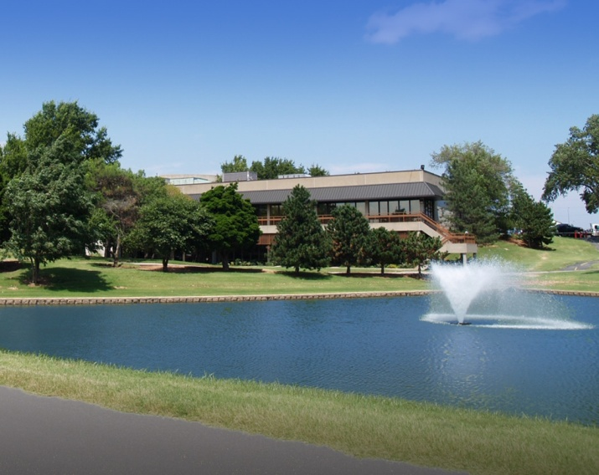

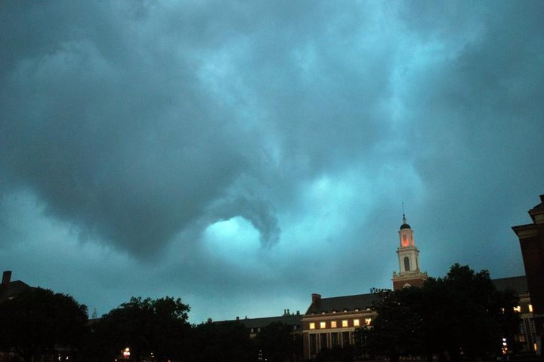

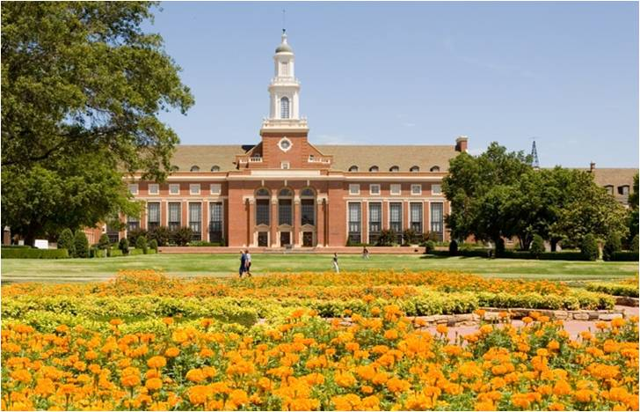
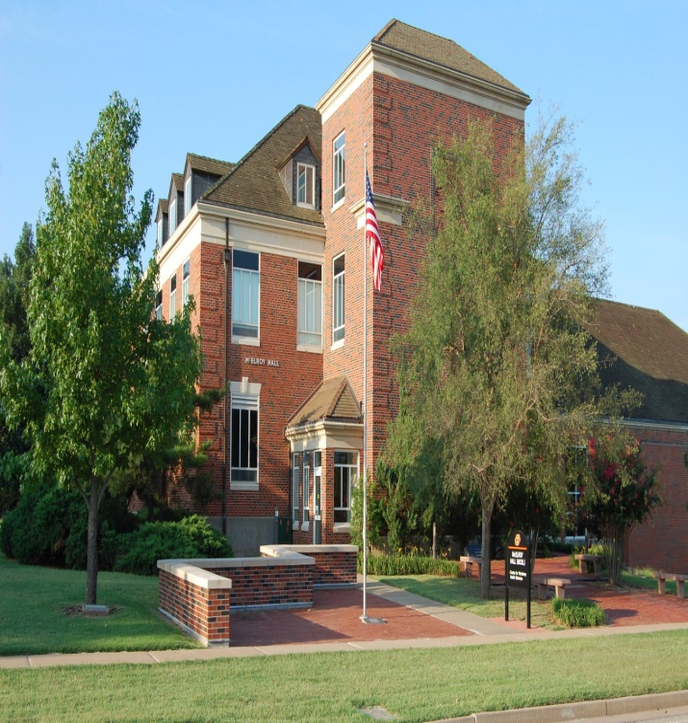
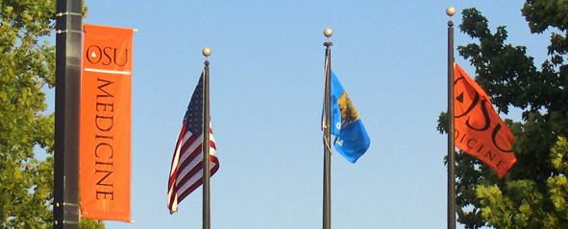
FY 2011 Budget

Slide 2

FY 2011 Budget Presentation
FY 2011 Proposed Budget
Auxiliary Enterprises
Enrollment
Requested Increases in Tuition and Mandatory Fees
Planning for FY 2012
Highlights

Slide 3
State Allocations – All Agencies

Slide 4
Educational & General Budget by Object - All Agencies

Slide 5
Sources of Revenue – All Agencies
FY 2010 FY 2011
Total Budget = $964.2M
Total Budget = $1,016M

Slide 6
Auxiliary Enterprises
Athletics - increases include debt service, contractual agreements, fringe benefits, financial aid, insurance, and repairs and maintenance. Ticket sales are forecasted to increase $1.5M in FY 2011 with the OU, Nebraska and Tulsa games being on the home schedule.
Resident Life - occupancy rates are expected to be up 150 students. A 3% revenue increase is expected for single student housing. With the refinancing of bonds, the fund balance has improved $7.0M.

Slide 7
Auxiliary Enterprises (con’t)
Student Union - projects a very conservative budget this year given the unknown impact the building renovation will have on economic engines. The renovation project is on schedule with a completion date of December 2011, and is currently running $2.1M under budget (total budget of $60.9M from the initial $63.0M). U-too was established to house the Bookstore, the Student Store and the dining area of the Student Union during the renovation process. It is located north of the Classroom Building.
University Dining Services - anticipates part of revenue moving to other dining units on campus, reduction in labor through more effective scheduling, greater control over food cost and analysis of product mixes to encourage students to eat on campus.

Slide 8
Enrollment
All-Time System Highs

Slide 9
FY 2011 Proposed Tuition & Mandatory Fee Rates General University & Tulsa - Undergraduate

Slide 10
FY 2011 Proposed Tuition & Mandatory Fee Rates General University & Tulsa - Graduate

Slide 11
FY 2011 Proposed Tuition & Mandatory Fee Rates OSU-Center of Veterinary Health Sciences

Slide 12
FY 2011 Proposed Tuition & Mandatory Fee Rates OSU Institute of Technology-Okmulgee

Slide 13
FY 2011 Proposed Tuition & Mandatory Fee Rates OSU-Oklahoma City

Slide 14
FY 2011 Proposed Tuition & Mandatory Fee Rates OSU-Center of Health Sciences

Slide 15
FY 2012: Planning for the Loss of ARRA Funds
Expand on Established Strategies to Increase Enrollment
Employ a Concentrated Effort to Improve Retention and Graduation Rates
Strategic Finance - Review of Academic Programs Looking at Cost of Program vs. Revenue Generated
Identify and Market Outstanding Academic Programs to Attract Top Students and Promote OSU Nationally
Continue Targeted Cuts
Enhance Other External Revenue Sources: Grants and Contracts, Intellectual Property, Private Fundraising, etc.

Slide 16
Highlights
Branding Success
February 2010 kicked off a one billion dollar campaign which will:
Enhance student scholarships
Increase faculty salaries to recruit and retain outstanding faculty
Allow for necessary expansion and renovation of facilities
Provide resources to help academic programs achieve national rankings
Scholar Awards:
Record number of scholar awards for FY 2010:
12 Bailey Trust Scholarships 3 Fulbright Scholars
4 Morris K. Udall Foundation Scholarships 1 Goldwater Scholar
8 National Science Foundation Fellows
Enrollment Growth:
Fall 09: enrollment growth of 75 students due to increases in new freshmen, transfers and graduate students
Fall 10: projecting increases of 250 undergraduate students and 200 graduate students

Slide 17
Highlights
Division of Agricultural Sciences & Natural Resources
The Oklahoma Agricultural Experiment Station accounts for approximately 37 percent of the research expenditures at OSU, used in conducting fundamental and applied research for the purpose of developing new procedural, product and technology improvements that address concerns and issues important to rural and urban Oklahoma.
Oklahoma Cooperative Extension Service county educators and area, district and state specialists work side-by-side with state residents, communities and organizations to help them make the best use of science-based innovations, with the goal of improving the quality of life for Oklahomans. On average, more than 1.05 million people attend or participate in 22,500 OSU Cooperative Extension educational meetings, demonstrations and conferences each year.
Center for Veterinary Health Sciences
Opened the Kirkpatrick Foundation Critical Care Unit for small animals.
Implemented an expanded Shelter Medicine program with 11 shelters in 8 communities.
Completed renovation of a biosafety level 2 laboratory in McElroy Hall.
Implemented an expanded transfer program to increase veterinary student enrollment in years 2 and 3.

Slide 18
Highlights
OSU Institute of Technology - Okmulgee
Completed construction of the Allied Health Sciences Center in August 2009, allowing an expansion of the institution’s registered nurse program.
Opened a new Day Care Center as a result of a major renovation of the commons area of the former Twin Towers dormitory.
Innovative and aggressive new student recruitment strategies and an increased focus on retention have contributed to enrollment growth in the Fall 2009 and Spring 2010 academic terms.
Oklahoma City
Enhanced professional development activities for full-time and adjunct faculty.
Student growth continues and we will accommodate future enrollment growth with available resources.
Construction on new Engineering Technology building to be complete by June 2011.

Slide 19
Highlights
Center for Health Sciences
CHS successfully negotiated the Academic Affiliation Agreement with OSU Medical Center and ensured the near term financial viability of the hospital.
Despite reimbursement declines and increasing numbers of uninsured patients, the OSU Physicians clinic system showed profits in FY 2010 and projects modest growth in 2011. CHS will add physicians to support the OSU Medical Center and begin managing several hospital owned physician practices. OSU Physicians Practice should exceed $20.0M in gross revenue for FY 2011.
FY 2011 continues the incremental growth in medical school admissions from 88 to 115 students per year with the admission of 94 students this fall.
CHS continues to transition the Health Care Administration masters program to their campus offering 5 courses from Tulsa in 2010-2011.
The Tulsa Police Department Forensics Lab/Evidence and Property Unit is fully utilizing the new 165,000 sq. ft. joint OSU/TPD facility constructed on campus. OSU’s forensic sciences program and biomedical research labs are scheduled to take occupancy in November 2010.

Slide 20
Highlights
Tulsa
Engaged faculty, staff, students and community (including representatives from Stillwater administration) in development of strategic initiatives for 2015. Now in draft form, plan will be finalized later this summer.
Researchers at the Helmerich Research Center are actively engaged in the following development projects: next generation nano-fiber composite materials; alternative energy sources; amorphous metal foam and honeycombs for next generation of aircraft and spaceships; recycling of post-consumer waste; and design, fabrication, and characterization of Micro/Nano-Electro Mechanical Systems.
A gift of $250,000 from BlueCross BlueShield of Oklahoma was secured to renovate and purchase new equipment for the Blue Cross Blue Shield of Oklahoma Health Promotion Lab and to create scholarships for the Health Promotion degree program.
In conjunction with CHS, the OSU-Tulsa clinic was opened in the North Hall building to provide convenient health care for students, faculty and staff.

Slide 21


